Slide 1
Fast and Accurate Time Series Classification with WEASEL
Patrick Schäfer, Ulf Leser, Humboldt University of Berlin
patrick.schaefer@hu-berlin.de, leser@informatik.hu-berlin.de
CIKM 2017, Singapore, 07.11.2017

Slide 2
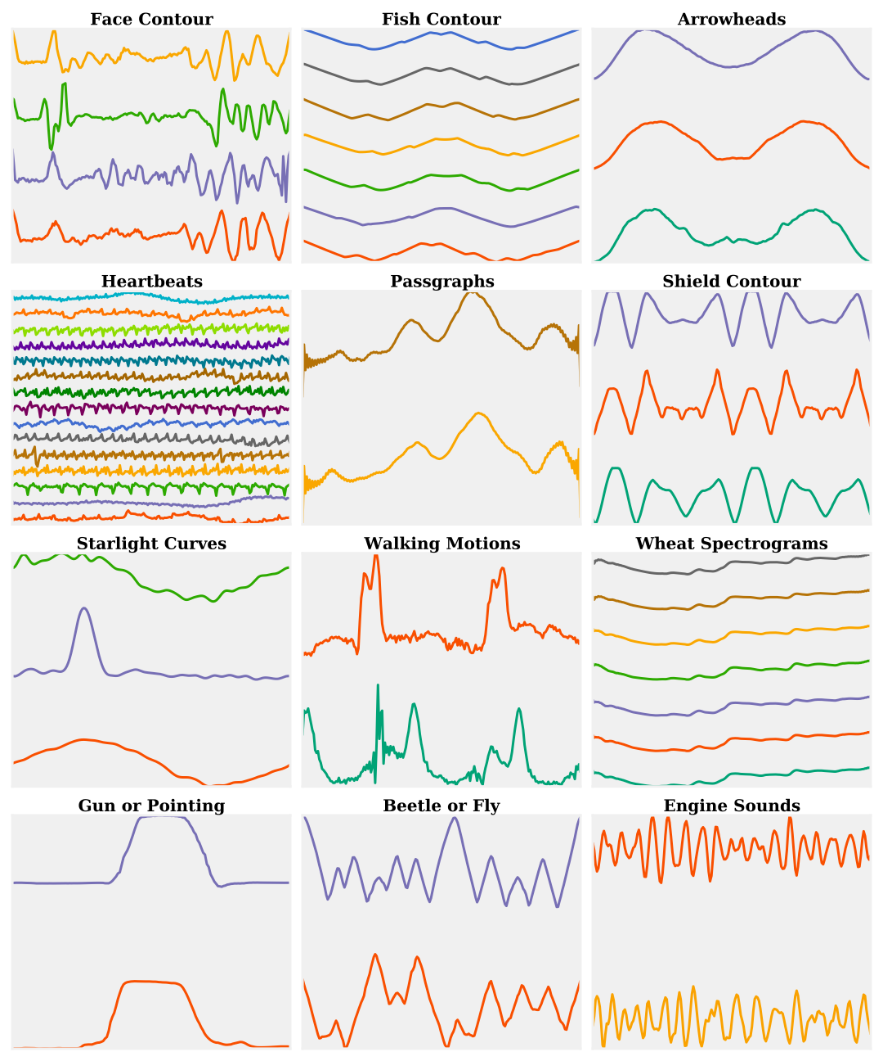
(Univariate) Time Series
Result from recording real-valued data over time.
Increasingly popular due to automatic sensors producing floods of large, high-resolution data.
Notes:
A univariate time series (TS) is a collection of values sequentially ordered in time.
They have become increasingly popular due to the growing importance of automatic sensors producing an increasing flood of large, high-resolution TS in areas
such as ECG signals, starlight curves, spectrograms, engine sounds, image contours (drawing with a pen around an object) or security (a person pointing with a finger or a gun towards you)

Slide 3



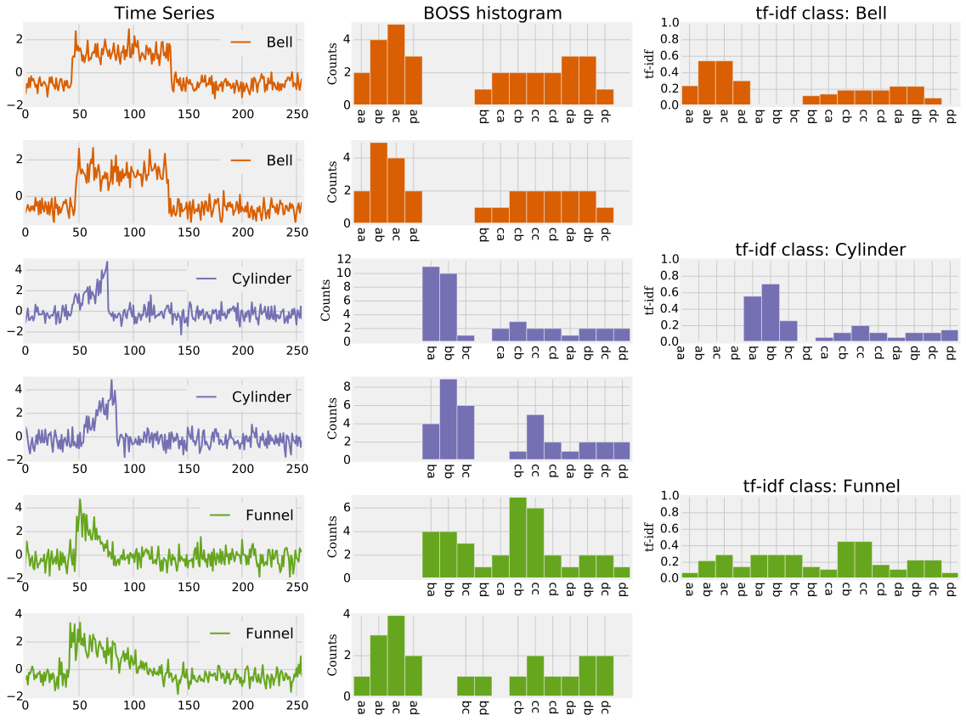

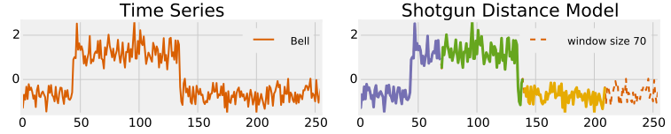

Time Series Classification (TSC)
Model
Assigns a class label to a query TS based on a model trained from labeled samples.
Most common baseline: 1-NN Dynamic Time Warping (DTW).
find
label
Query
Notes:
TS classification aims at assigning a label to a query based on a model trained from labeled samples.
Most common baseline is 1-Nearest-Neighbor with distance measure Dynamic Time Warping. The query is assigned to the most similar (closest) TS.
On the right we see the CBF datasets composed of three prototypes: bells, cylinders and funnels.

Slide 4
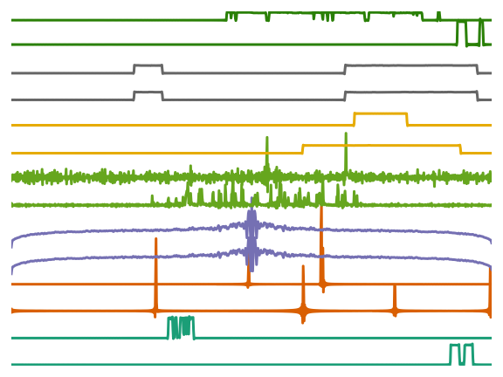
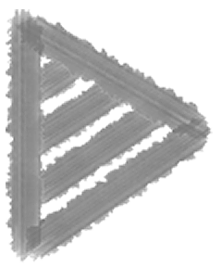
Scalability I
Sensor-driven applications produce (a) very long and (b) very large TS.
Consider millions of customers each having dozens of devices, each one recording one measurement per second.
Several millions of classifications of TS have to be performed every hour.
TSCs are required that are both fast and accurate.
Daily power consumption. Bottom to top: dishwasher, microwave oven, digital receiver, coffee-maker, amplifier, lamp, monitor.
Notes:
We are nowadays facing very long and/or very large TS in sensor-driven applications.
An energy company may wish to forecast the energy consumption in smart grids by detecting the types of electronic devices based on their consumption profiles.
These electronic devices are characterized by long idle periods, small bursts of high energy consumption and noise.
Consider the company has millions of customers, each having dozens of devices, recording one measurement per second. Thus millions of classifications have to be performed every hour.
Thus, we need fast and accurate classifiers.

Slide 5
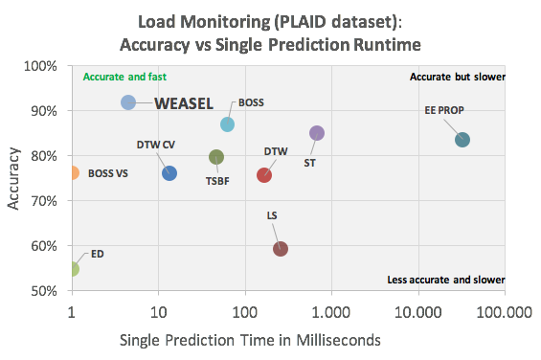
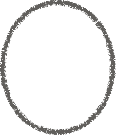
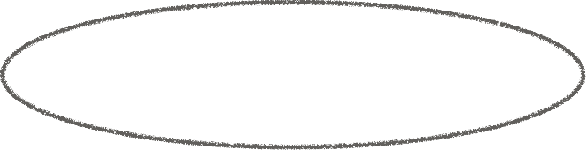
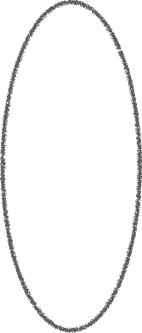
Scalability II
State of the art is either:
scalable (few ms) but offers inferior classification quality (<80%), or
accurate (>90%) but does not scale (about 1s).
Notes:
We compared nine state-of-the-art classifiers on an energy consumption dataset (1074 samples of variable length 102 to 103) stemming from 11 different devices.
On the x-axis we see the prediction time for a single query. On the y-axis there is the average accuracy on the UCR datasets.
KLICK
In summary, there are fast methods that require around ms per prediction, but have an accuracy below 80%;
The most accurate methods achieve 85%-88% accuracy, but require a few 100ms up to 32sec for prediction.
Ideally, we would like to have a method that is both scalable and fast.
WEASEL is a first step to this problem.
BOSS and BOSS VS have previously been published by us.

Slide 6
Can we build a classifier that is faster than but as accurate as state of the art?
Notes:
Our research focusses on classifiers with a low computational complexity combined with high accuracy.

Slide 7
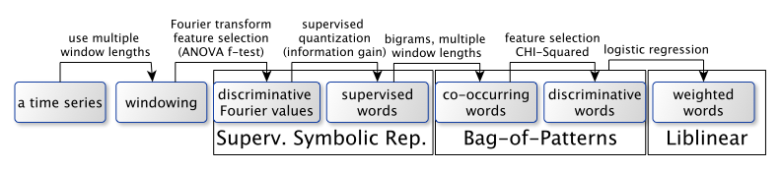
WEASEL: Word ExtrAction for time SEries cLassification
Design motivations and building blocks:
Accuracy: Extract discriminative features (multiple window lengths, noise reduction, supervised words, co-occurring words)
Scalability: Statistical feature selection and logistic regression for fast classification.
Notes:
Our key design motivations are accuracy and scalability.
Weasel is based on a
symbolic transformation,
the Bag-of-Patterns model,
feature selection and
a logistic regression classifier.
First, subsequences (windows) are extracted from a time series.
The Fourier transform is applied to these windows and then it is discretized to words.
To get high accuracy, these words should only be present in its class, thus we propose a supervised symbolic transformation and add bigrams for order-awareness of words.
To be scalable, we have to aggressively reduce the feature space using statistical feature selection (CHI-squared test) and logistic regression.

Slide 8
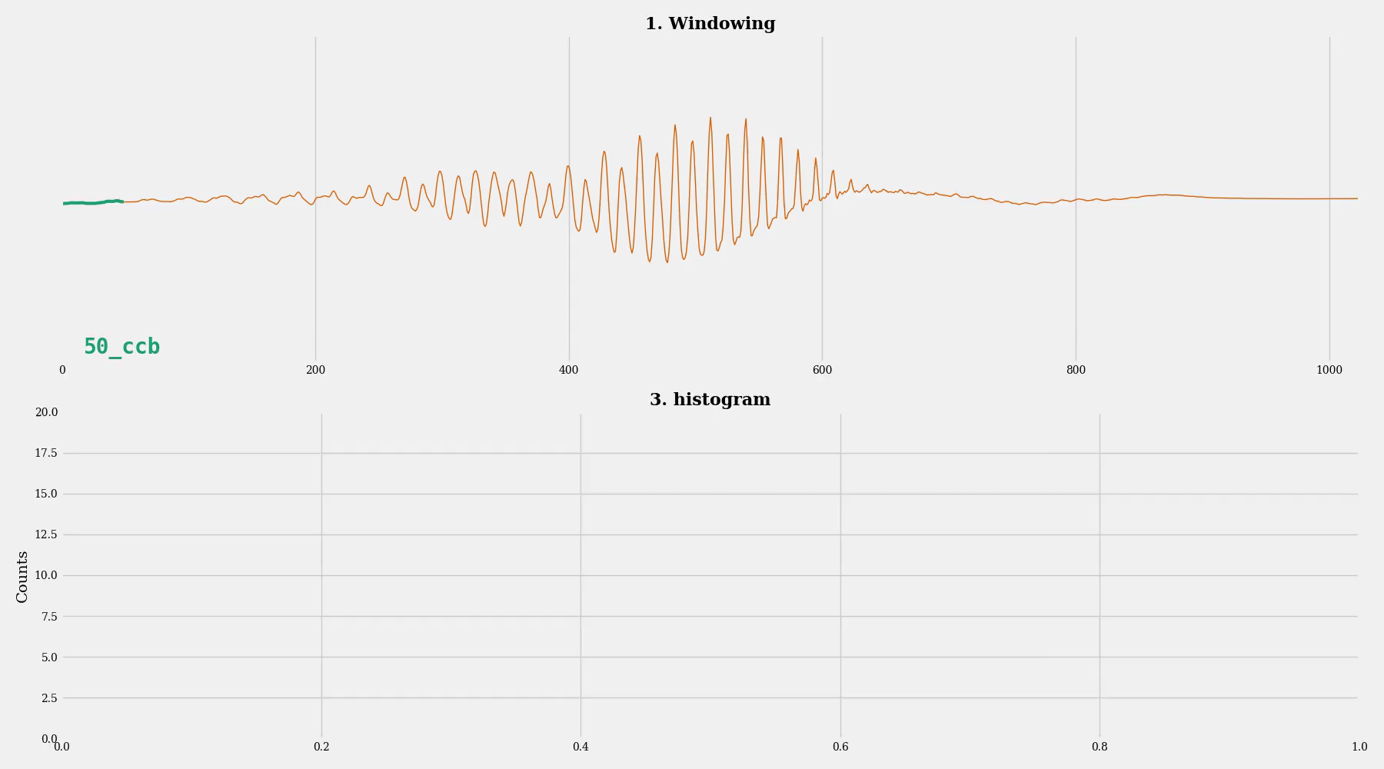
Notes:
In the bag-of-patterns model, two TS are distinguished by the frequency of occurrence of substructures (words).
Feature are words or histogram over words.
So, how does this work:
First, we break up a TS into a bag of substructures of fixed lengths.
Words (and bigrams) are generated from these substructures using discretization.
And a histogram of feature counts is built and used as input to classification
Next we add words (and bigrams) for the next window length.
Feature space explodes and we have to apply some kind of feature selection.
Also we are mostly interested in those words that appear in just one class.

Slide 9
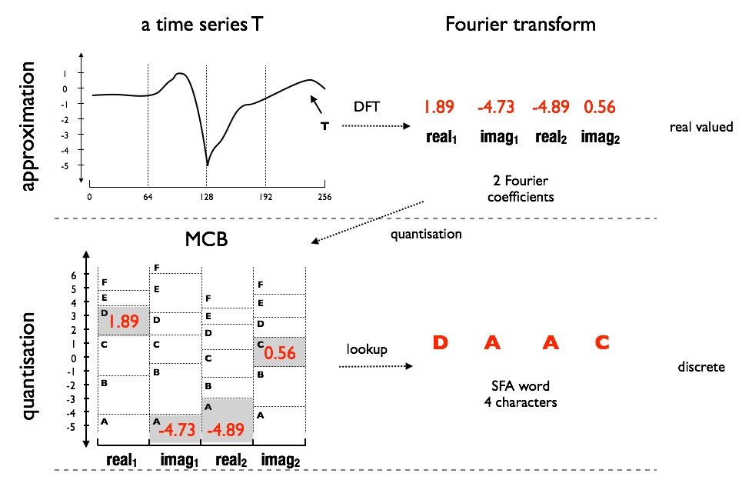


(Supervised) Symbolic Representation
Represent each real valued TS by a sequence of symbols, using a finite alphabet.
Building blocks:
Supervised Approximation using the Fourier Transform (noise reduction)
Supervised Quantization for obtaining symbols
choose discriminative Fourier coefficients using ANOVA F-test
use information gain binning to pick „pure“ class split points.
Notes:
The symbolic representation represents each TS by a sequence of symbols (word)
It first, transform a time series using the Fourier transform, e.g. to 4 values.
It then quantizes each Fourier value to a symbol.
For example 1.89 falls into the interval D, and so on.
So, how to choose the best Fourier coefficients? In our previous works, we chose the first ones. Here we apply an ANOVA F-test to select those that best separate the class labels.
Next we select those split points that best separate the classes using information gain binning.
I am not going into the details, which are described within the paper.
TODO
- lasso (elastic net)

Slide 10
Feature Extraction and Selection
Feature Extraction:
Extract windows at multiple lengths.
Obtain words using a supervised symbolic transformation.
Capture order of windows using word co-occurrences (bi-grams).
Feature Selection:
Chi2-test extracts most distinctive features for each class label.
Linear time logistic regression classifier (liblinear) is used for training weight vectors.
Both highlight features that are characteristic for a class label.
Notes:
Thus, WEASEL builds a huge feature space using multiple subsequence lengths and uses bi-gram.
It then applies the Chi-squared test to pick the most distinctive features and removes the rest.
The logistic regression classifier further weighs each feature and thus removes remaining features.

Slide 11
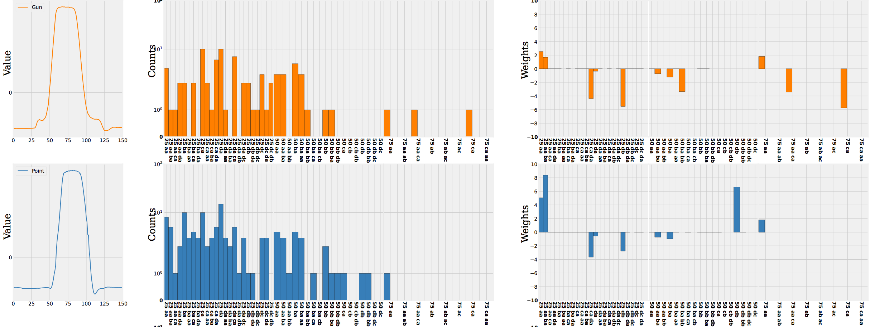
After Feature Extraction
Windowing (e.g. 25, 50,75), Words, Bigrams
After Feature Selection
Chi-Squared, Logistic Regression
Raw Time Series
Notes:
Here is an example for the effect of the chi-squared test and logistic regression.
First, features are extracted from the time series (center). and on the right you can see that most features are removed and only some characteristic features remain.
Thereby, one can distinguish the classes by the absence or presence of these few features (words).

Slide 12
Experiments
UCR time series archive is the benchmark dataset in TS research.
These 85 datasets allow for reproducibility and comparability of methods.
Covers many applications: synthetic, motion sensors, sensor readings and image outlines.
Notes:
We performed a series of experiments on the UCR TS classification archive.
The dataset contains 85 TS datasets from a whole range of applications including:
synthetic, motion sensors, sensor readings and image outlines.
It is commonly used for TS research.
Image outlines result from drawing a line around the shape of an object.
Motion recordings can result from video captures or motion sensors.
Sensor readings are real-world measurements like spectrograms, power consumption, light sensors, starlight-curves or ECG recordings.
Synthetic datasets were created by scientists to have certain characteristics.

Slide 13
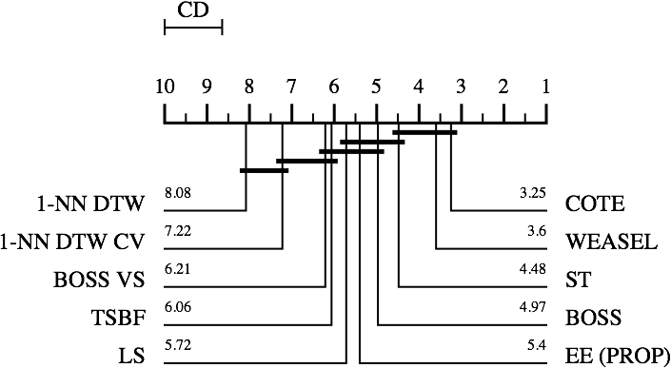
Average Ranks on UCR datasets
WEASEL is as accurate as state-of-the-art classifiers.
It is more accurate than all non-ensembles and as accurate as COTE.
Notes:
This plot shows the critical distance diagram for the state-of-the-art classifiers. The classifiers with the lowest average ranks, are best.
These ranks are based on the 85 UCR datasets.
An ensemble of 35 classifier COTE is the most accurate but WEASEL has a competitive accuracy.
Furthermore, it is more accurate than all other core classifiers (non-ensembles)
DTW is the most common baseline but performs worst

Slide 14
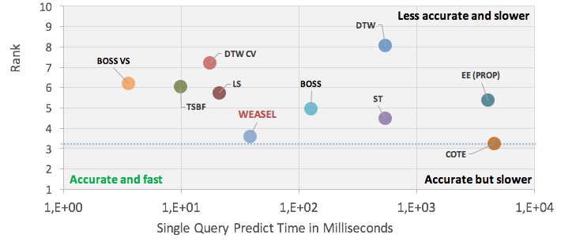
Trade-off between Accuracy and Runtime
On the 85 datasets, WEASEL is as accurate as state-of-the-art classifiers but has orders of magnitude lower prediction times.
The same is true for train times (not shown here)
Notes:
We look at the average rank plotted against the total runtime. Ideally we want a method that is in the lower left corner: fast and accurate.
Again you can see accurate but slow classifiers and fast but less accurate classifiers.
The highly accurate classifiers take the longest, except for WEASEL, which has a moderate prediction time but is as accurate as COTE.
For WEASEL a single prediction takes 38ms on average.

Slide 15
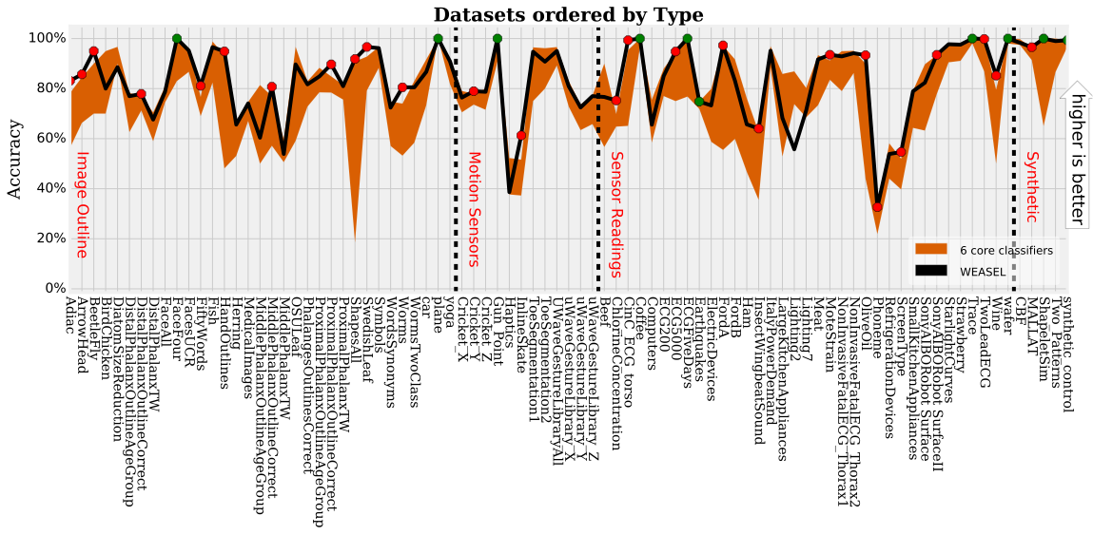
When dividing the datasets into domains…
WEASEL performs accurate independent of the dataset domain.
It has 36 out of 85 wins when compared to the other core classifiers.
Notes:
The area represents the accuracy of the 6 state of the art classifiers. The black line is the accuracy of WEASEL.
When split to dataset domain (image outline, motion sensors, sensor readings, synthetic) we can see that WEASEL (black line) is always close to the best method and rarely worse.
Overall it has 36 wins (red or green dots).

Slide 16
Conclusion
Highly accurate classifiers perform extensive training and have high test times.
WEASEL builds a highly discriminative bag-of-patterns feature space using statistical feature selection, word co-occurrences, and a supervised symbolic representation.
On the UCR datasets WEASEL is among the fastest and most accurate classifiers. Competitors are either much slower or much worse in accuracy.

Slide 17
Thank you!
https://github.com/patrickzib/SFA

Slide 18
Univariate State-of-the-Art Classifiers
Whole Series
1-NN Dynamic Time Warping
1-NN Euclidean Distance
Shapelet-based
Fast Shapelets (FS)
Learning Shapelets (LS)
Shapelet Transform (ST)
Ensembles of Core Classifiers
Elastic Ensemble (EE PROP)
Collective of Transformation Ensembles (COTE)
Bag-of-Patterns / Bag-of-Features
Bag of Patterns (BoP)
SAX VSM
Time Series Bag of Features (TSBF)
Bag-Of-SFA-Symbols (BOSS)
Bag-Of-SFA-Symbols in Vector Space (BOSS VS)
Word ExtrAction for time SEries cLassification (WEASEL)
Trends: Deep Learning
Notes:
State of the art classifiers can be separated into 4/5 groups.
Whole series, Shapelet-based, Ensembles, Bag-of-Patterns and most recently deep learning based approaches.

Slide 19
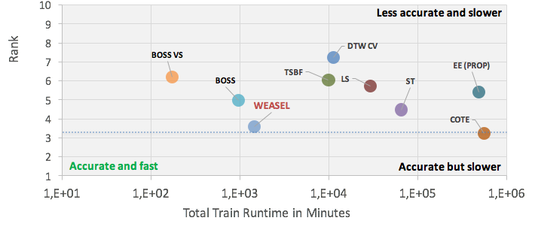
Trade-off between Accuracy and Runtime
Weasel is as accurate as state-of-the-art classifiers but orders of magnitude faster.
Notes:
What we see: average accuracy plotted against the total runtime. Ideally we want a method that is in the upper left corner: fast and accurate.
In the left corner there is the prediction time. In the right corner there is the train time. There are huge differences in train and test times.
Shapelet methods have a higher train time. Bag-of-pattern methods generally have a lower runtime. Ensembles have highest runtimes.
But the high accuracy classifiers take the longest, except for WEASEL, which has a moderate prediction time but is as accurate as COTE.

Slide 20
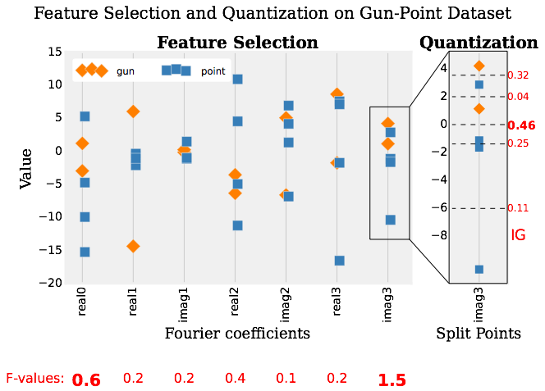
Supervised Symbolic Representation
Motivation: generate words that discriminate (not equally frequent) between class labels.
Approximation: Fourier transform each window.
Feature selection: Select maximally discriminative Fourier coefficients using ANOVA F-test.
Quantization: Apply information gain binning to choose quantization boundaries that best separate class labels.
Notes:
Here we use a class-aware quantization. Thus, we find those split points, that best separate between class labels by use of Information gain.
In the picture the imag3 value is best for splitting between classes.
The one-way ANOVA F-test checks the hypothesis that two or more groups have the same normal distribution around the mean. We are interested in the largest F-values, equal to large differences between group means
This differs from previous approaches, like SFA [37] or SAX [20], which rely on fixed, data-independent intervals, possibly leading to features equally frequent across classes

Slide 21
Bibliography
P. Schäfer and M. Högqvist. SFA: a symbolic Fourier approximation and index for similarity search in high dimensional datasets. In Proceedings of the 2012 International Conference on Extending Database Technology, pages 516–527. ACM, 2012.
I. Potamitis and P. Schäfer. On classifying insects from their wing-beat: New results. Ecology and acoustics: emergent properties from community to landscape, Paris, France, 2014.
P. Schäfer. The BOSS is concerned with time series classification in the presence of noise. Data Mining and Knowledge Discovery, 29(6):1505–1530, 2015.
P. Schäfer. Scalable time series classification. Data Mining and Knowledge Discovery, 30(5), pages 1273-1298, 2016.
P. Schäfer and U. Leser. Benchmarking Univariate Time Series Classifiers, BTW 2017.
WEASEL: Word ExtrAction for time SEries cLassification, CIKM 2017.

